Slide 1

The Andover Rotary Club is requesting help with its
2016 International Project
Providing clean and reliable water to the Zvidosvevanhu school in Zimbabwe

Slide 2


Slide 3

The purpose of the Chiredzi River African Wildlife Trust is to preserve and protect sustainable wildlife and wild spaces in the Chiredzi River Conservancy (CRC)
The Chiredzi River African Wildlife Trust
Established in 2009
A 501(c)(3) exempt organization.
www.crawt.org

Slide 4
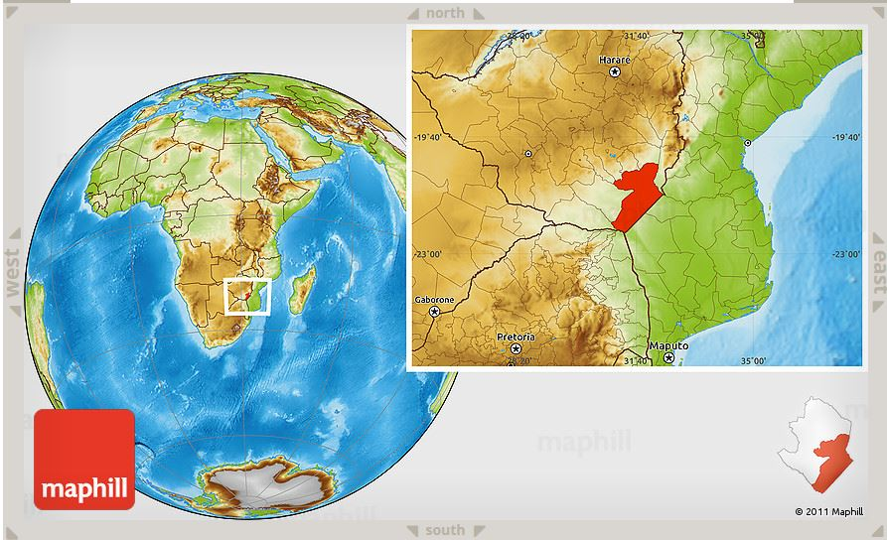
Our efforts are focused on the species, habitat, and people of the southeast Zimbabwe Lowveld
Our goal is to decrease the human - wildlife conflict in the Core Wildlife Area.

Slide 5
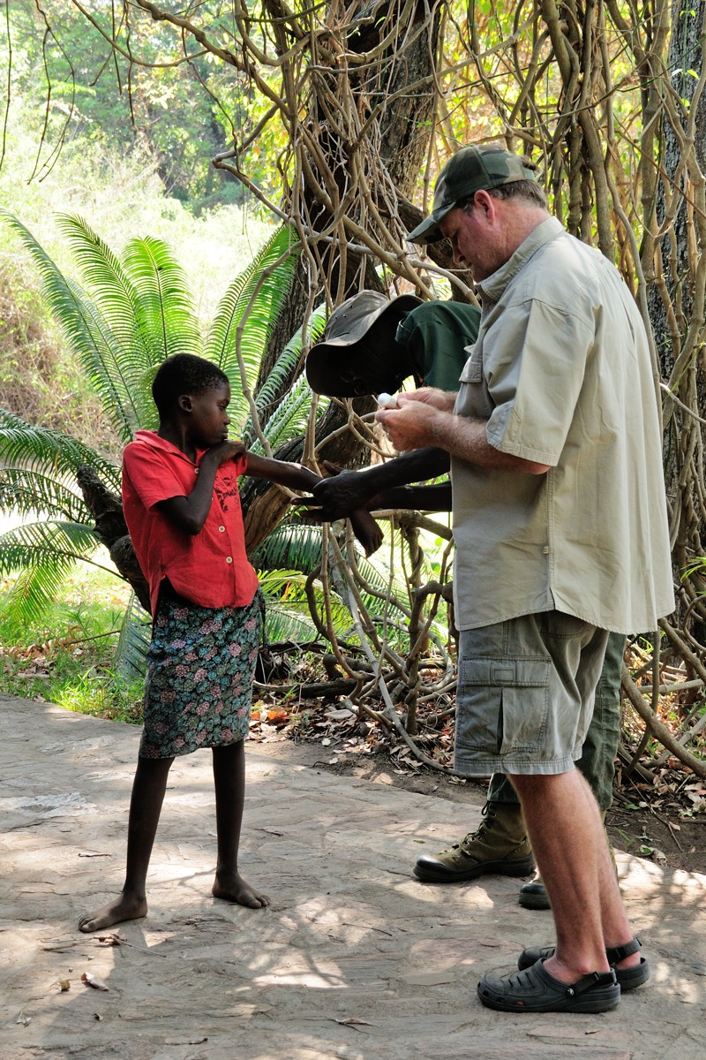
Barry Style is a third generation Zimbabwean. He’s our managing director (and amateur doctor) on the ground in Zimbabwe.
Here he is seen prescribing antibiotic ointment and Lifesavers to the daughter of one of our game scouts.

Slide 6
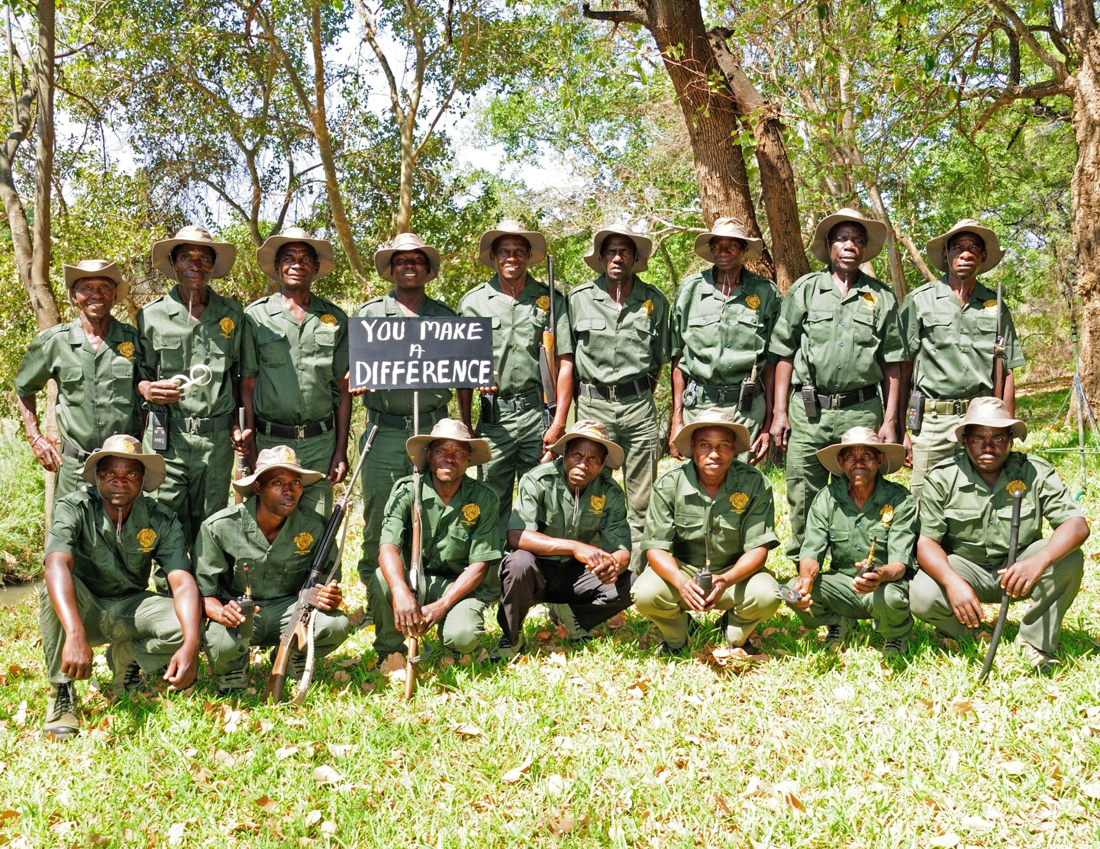
This is our team of anti-poaching game scouts.
They are our eyes and ears on the ground, and ambassadors to the communities.
They arrest poachers, clear snares, fight wildfires, and assist in our many efforts to help the local communities and wildlife.

Slide 7
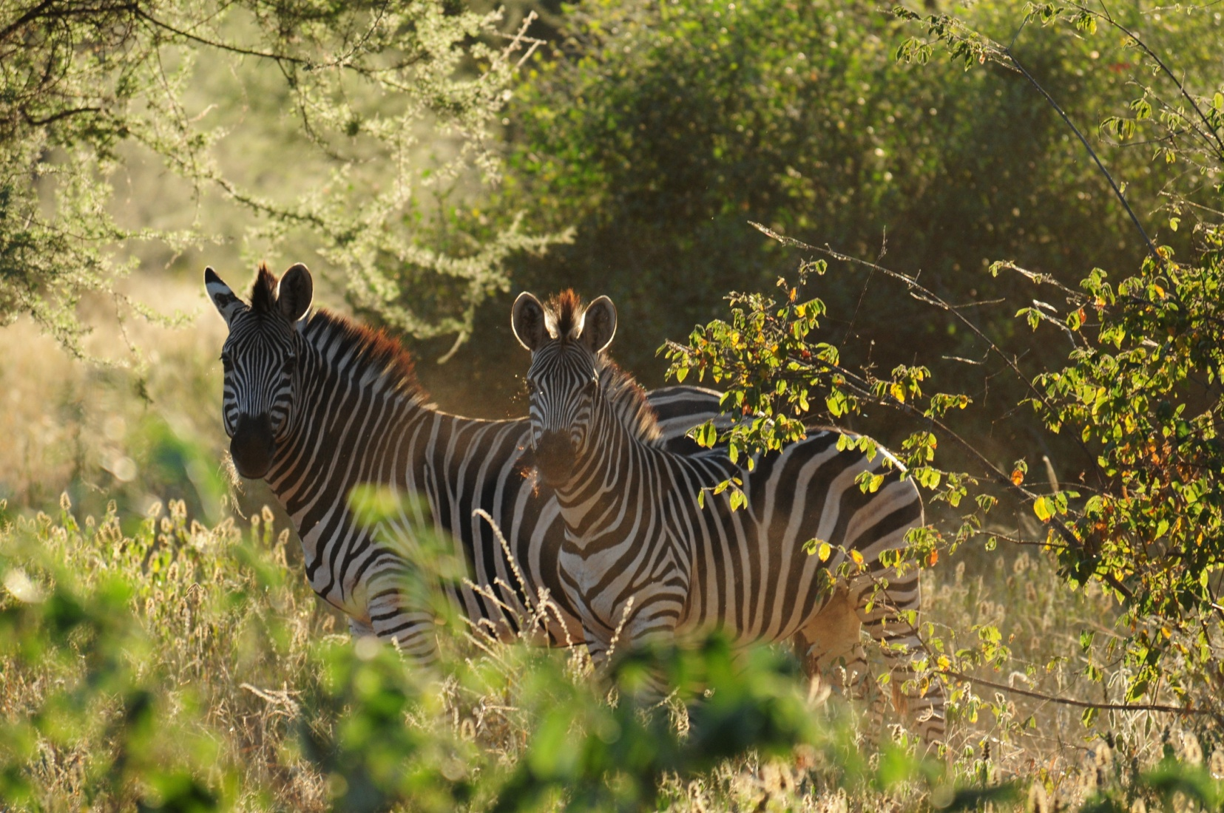
The CRC is primarily a wildlife area that is suitable for grazing, but not farming or mining. Our conservation efforts are concentrated here.
In our efforts to educate the community about sustainable wildlife and habitat being a valuable commodity, we became involved with two schools in the CRC.
Ruware, the larger school of almost 700 students, and Zvidosvevanhu with almost 200 students.

Slide 8
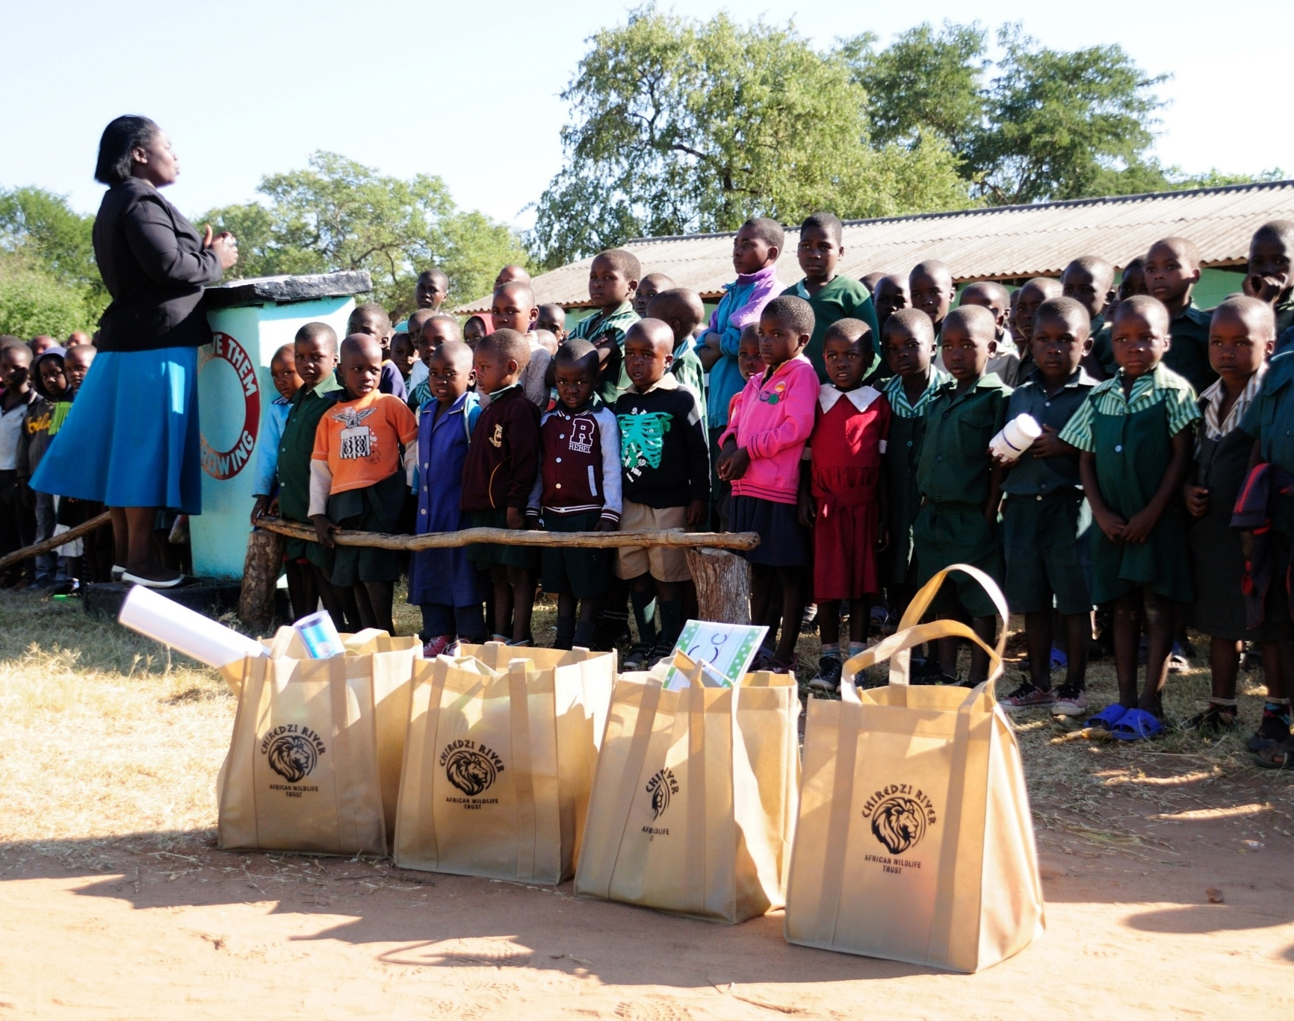
The CRAWTrust makes yearly visits to both schools to provide much needed school and medical supplies.

Slide 9
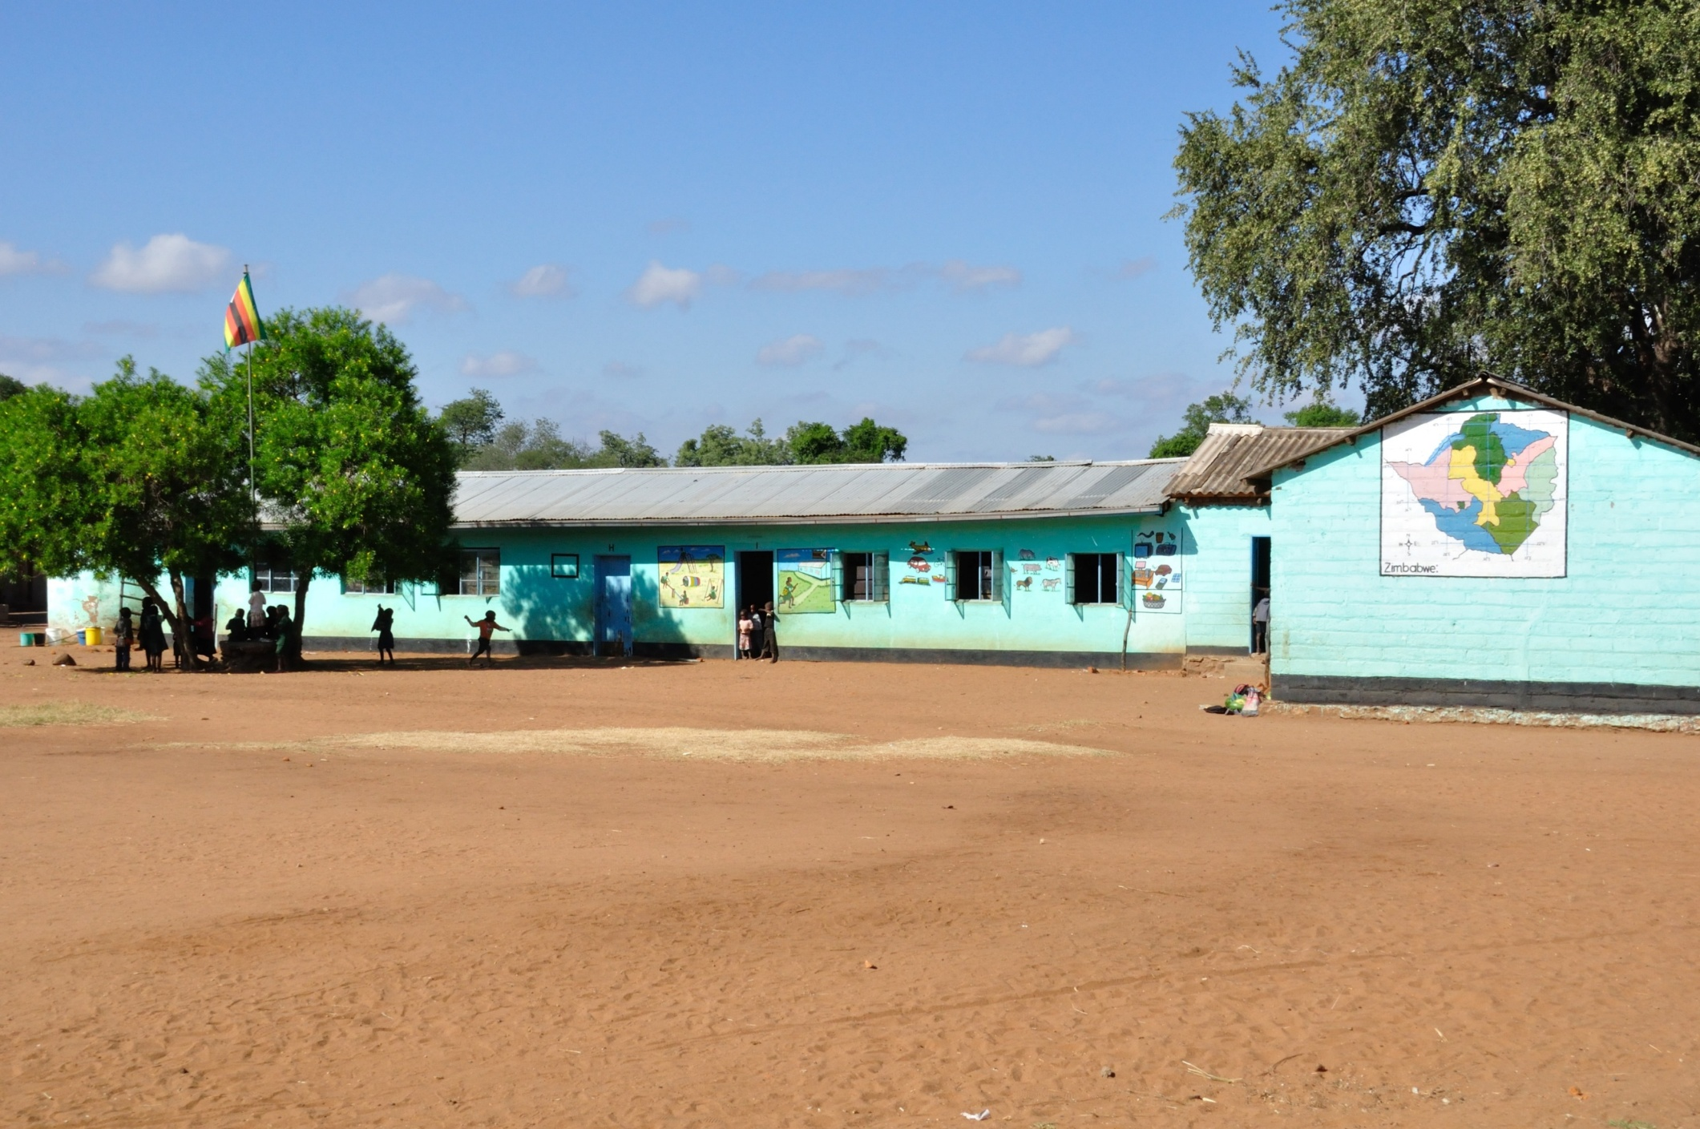
This is Ruware School

Slide 10
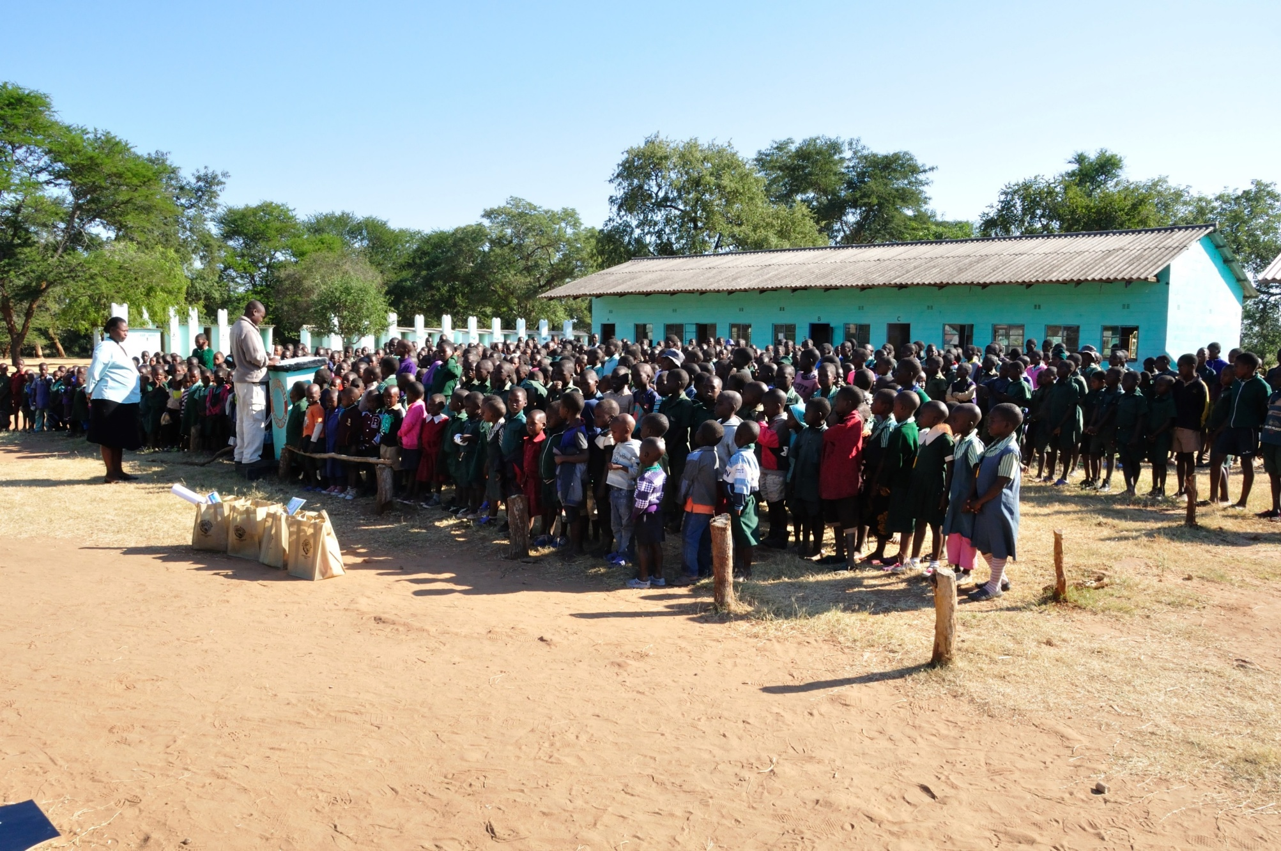
Morning Assembly at Ruware

Slide 11
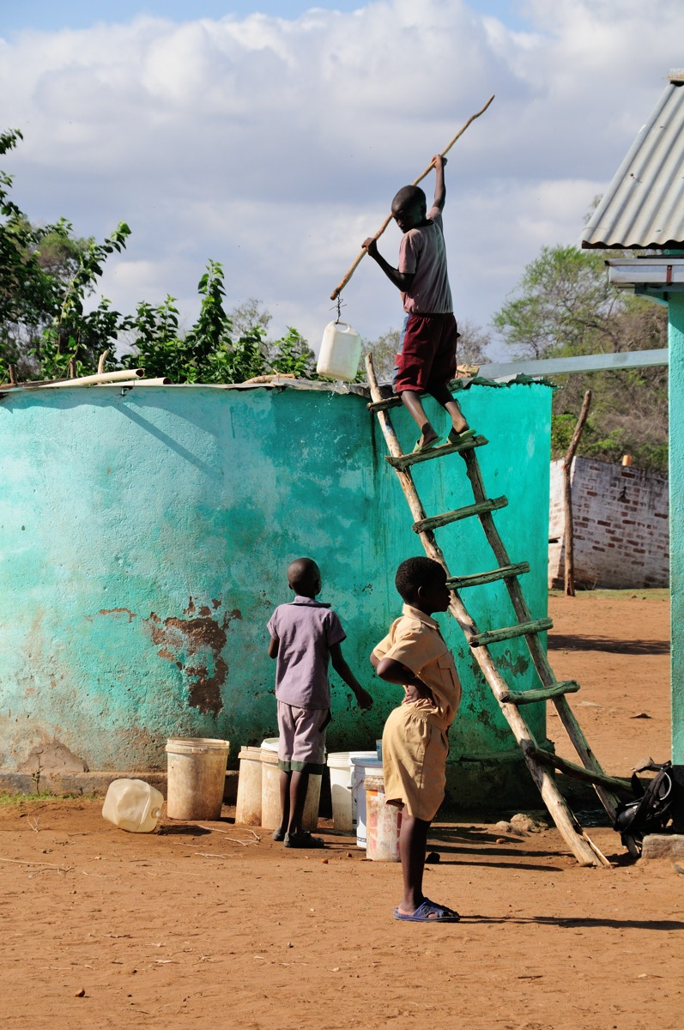
In our 2015 visit to Ruware school, this holding tank was down to two feet of water.
Power cuts are common in Zimbabwe. Without electricity to run the water pump, the school was unable to keep the holding tank full.
The students were at risk of running completely out of water.

Slide 12
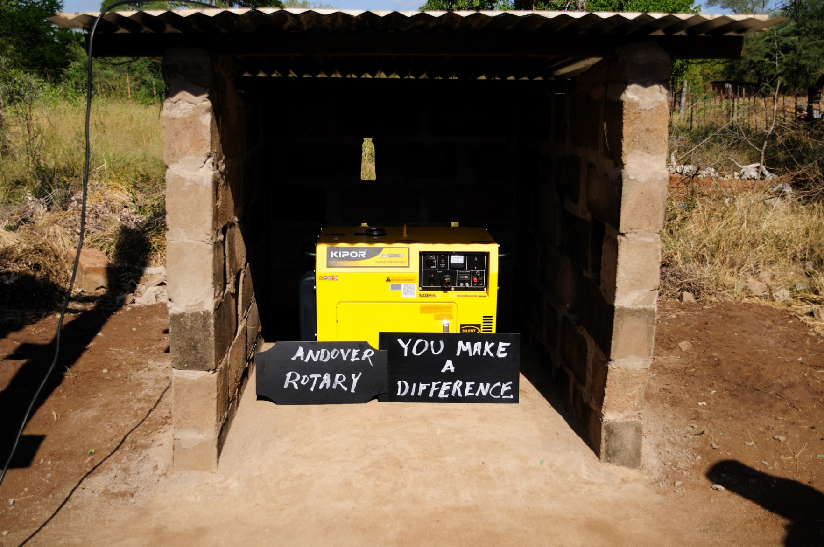
Upon our return from Zimbabwe, the CRAWTrust appealed to the Rotary Club Of Andover.
In short order, they approved the purchase of a new generator.
The school now has a reliable way to ensure the pump keeps running to supply water.

Slide 13
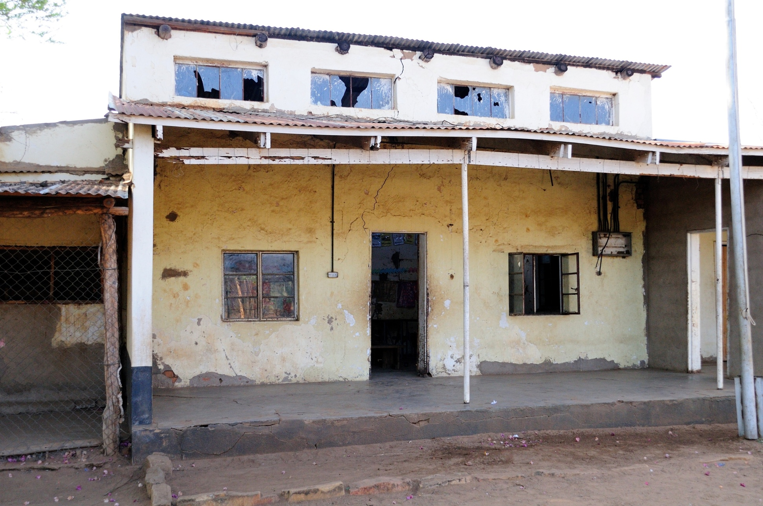
This is Zvidosvevanhu School

Slide 14
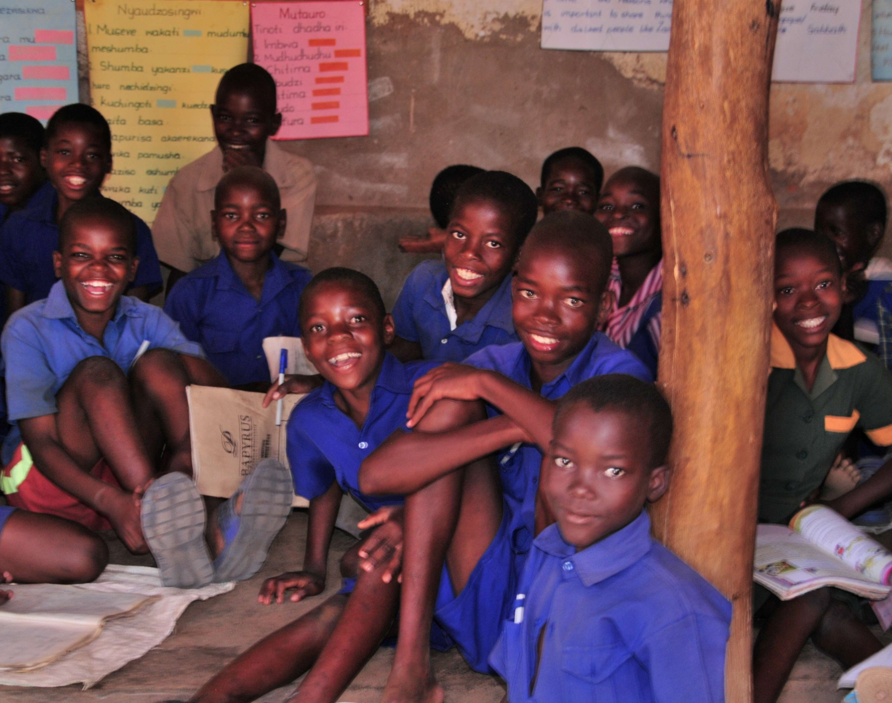
Zvidosvevanhu is a hodge podge of buildings. It had only ten desks when we were there in October of 2015. Those desks seated 30-40 students out of 170.
The Rotary Club of Andover once again came through and agreed to match us desk for desk up to twenty desks.

Slide 15

We put the word out and in a matter of days raised enough for twenty desks (and a few extra). With the matching twenty desks from The Rotary Club of Andover, we had all the students off the ground.

Slide 16
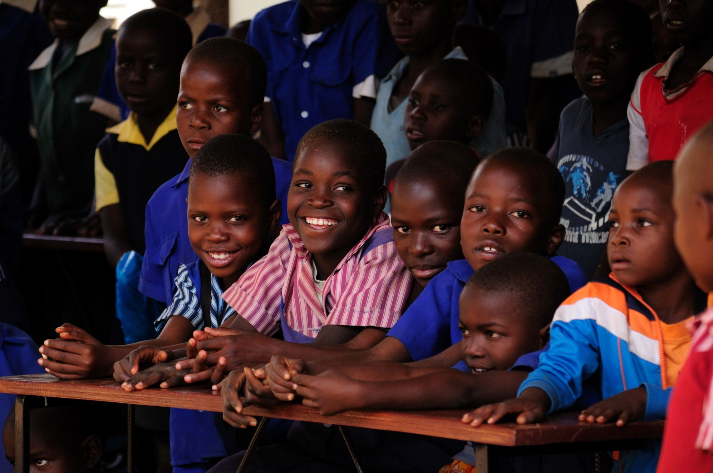
This is May 2016 with some proud youngsters behind their new desks.

Slide 17
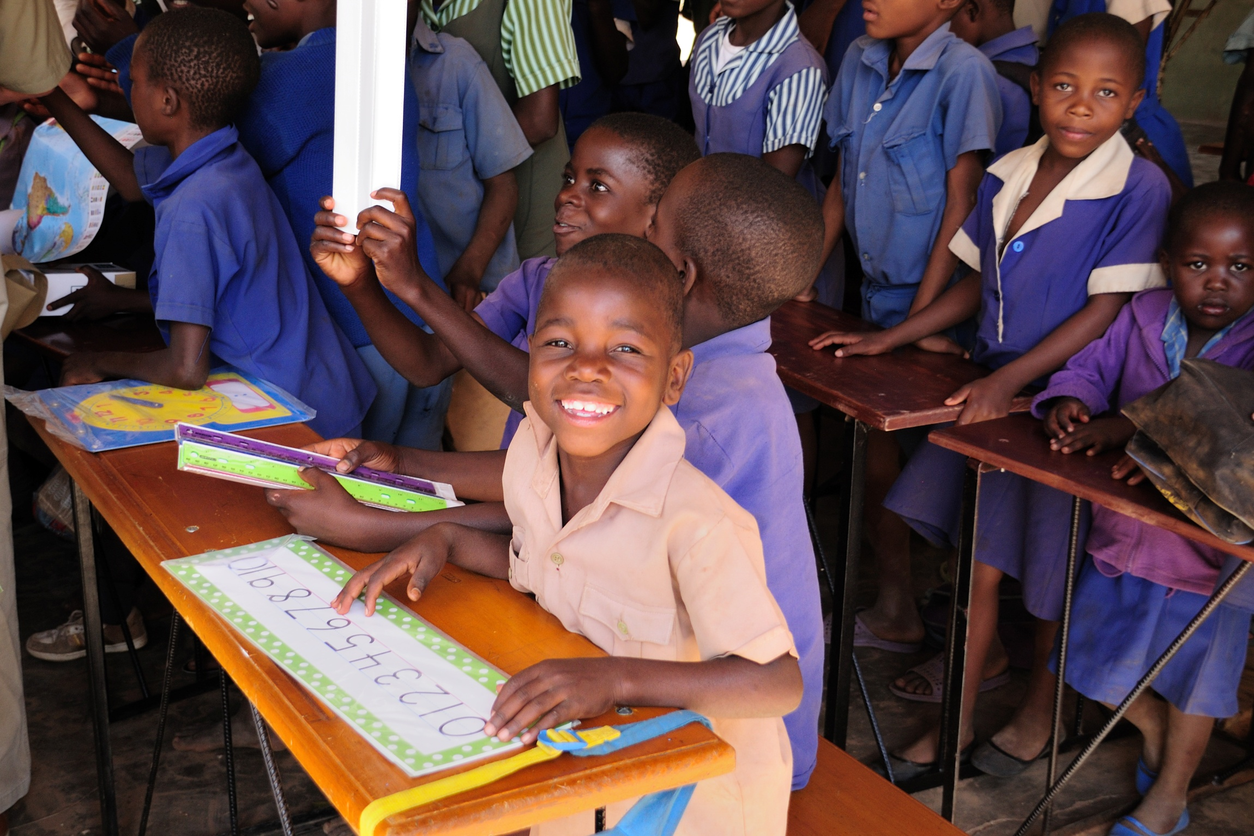
The language spoken in this part of Zimbabwe is Shona. Zvidosvevanhu means “interest of the people”
Fortunately for us, Everyone smiles
in the same language.

Slide 18
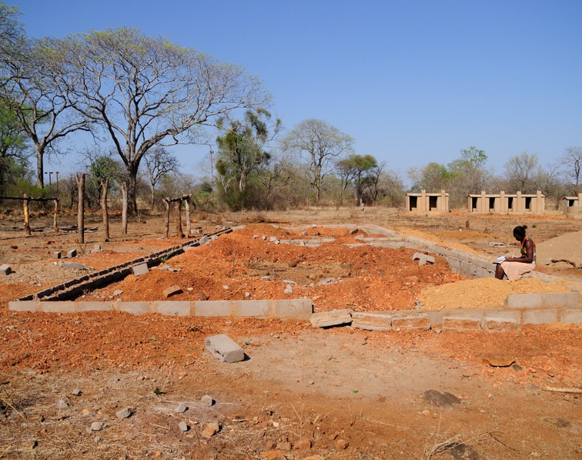
This is the site of the new Zvidosvevanhu school as it looked in the fall of 2015.
There is no water supply for building or drinking at this site.

Slide 19
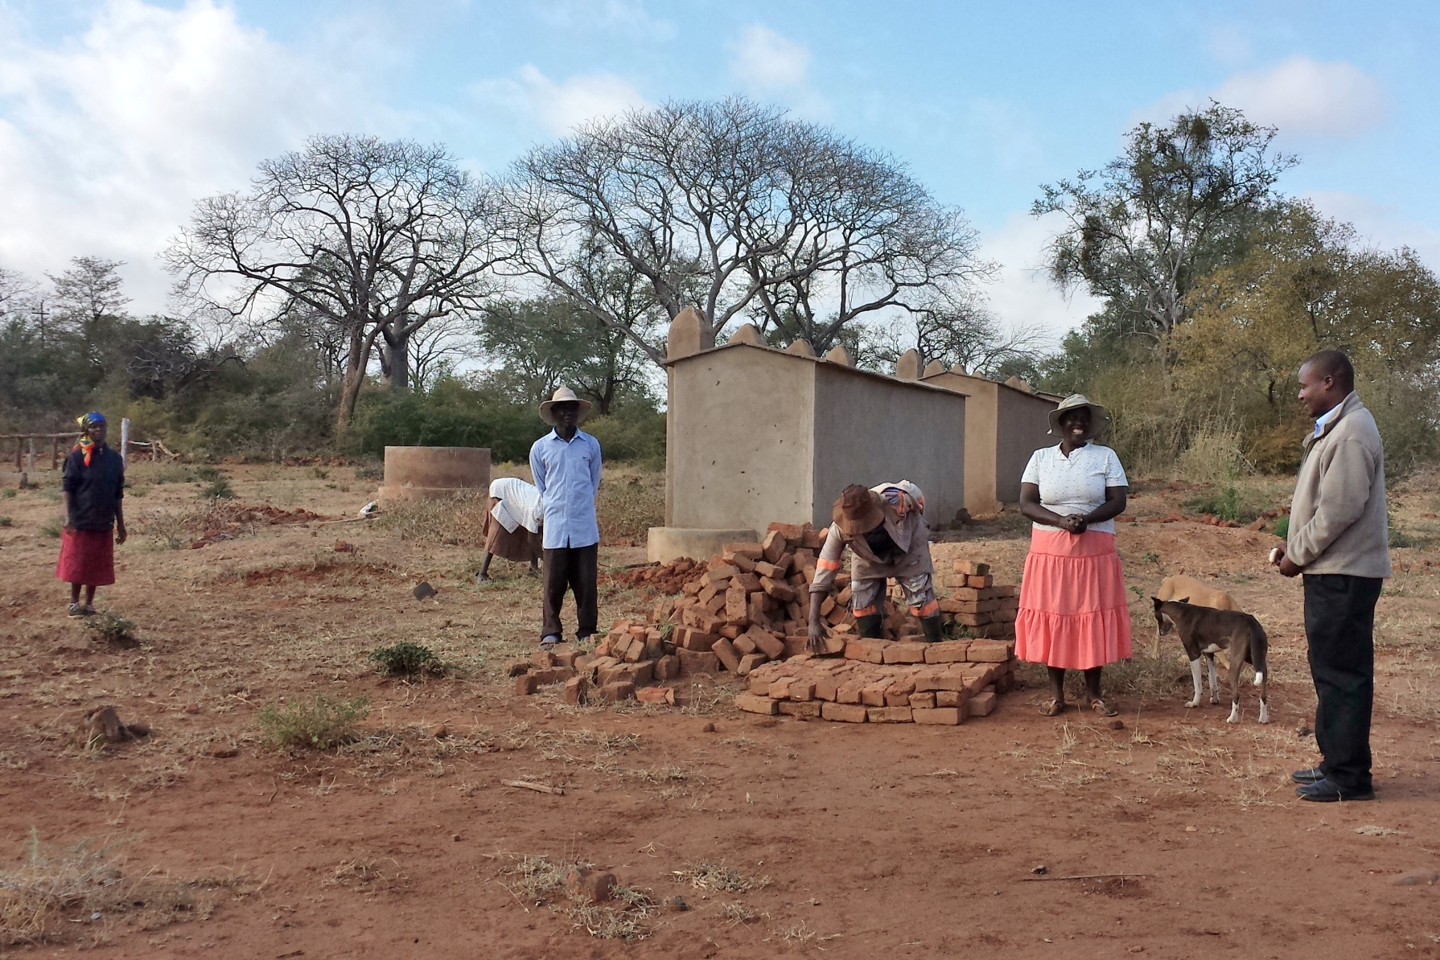
This is the progress made in seven months time. It’s a difficult community project when water to make bricks and mix cement must be carried from the river in five gallon buckets.
The Chiredzi River is in the Core Wildlife Area.

Slide 20
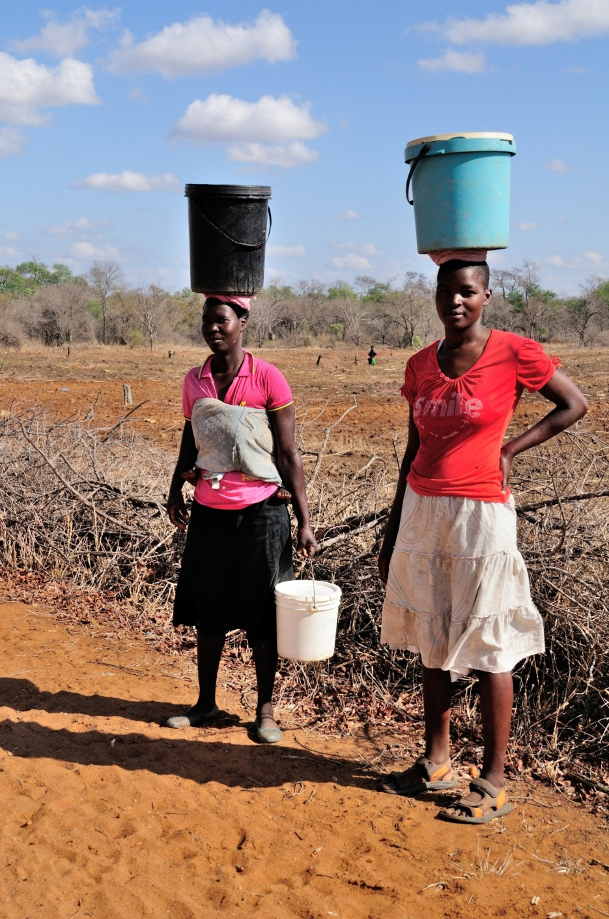
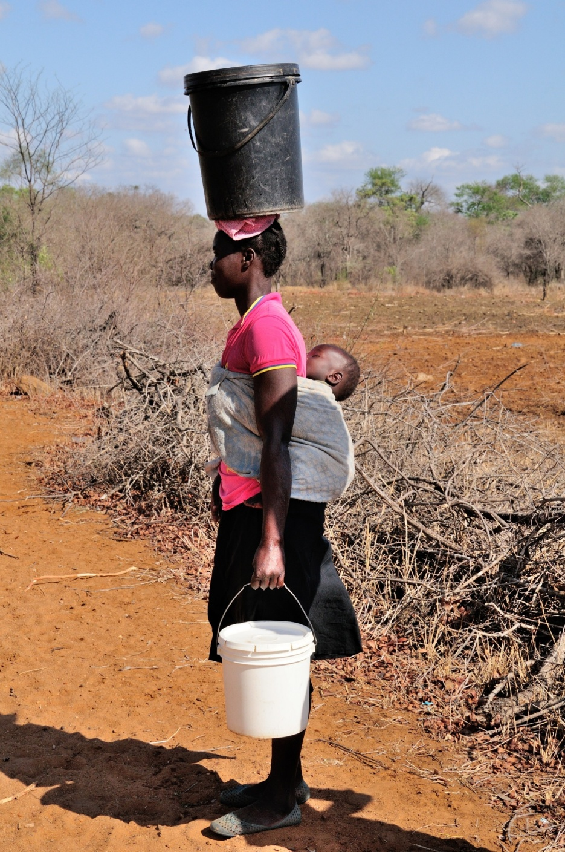
Establishing a water source to the new Zvidosvevanhu school is a high priority.
Not only will it help expedite the construction of the new school, it will provide a clean water supply to the students and eliminate the need to enter the Core Wildlife Area.

Slide 21
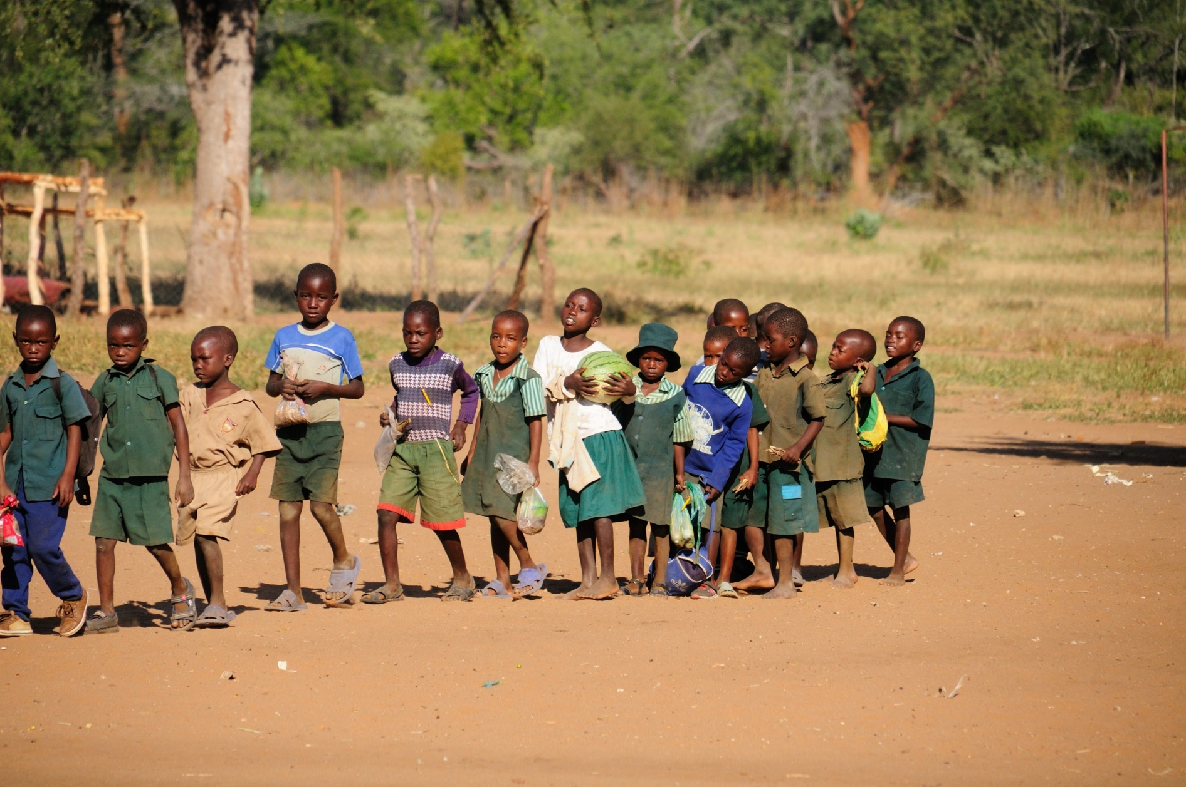
Once we have achieved our goal to provide water, our long term project is to provide one hot meal each school day to the students of both schools.
Many of these children walk miles a day to attend school with nothing to eat while there.
It’s tough to learn on an empty stomach.

Slide 22
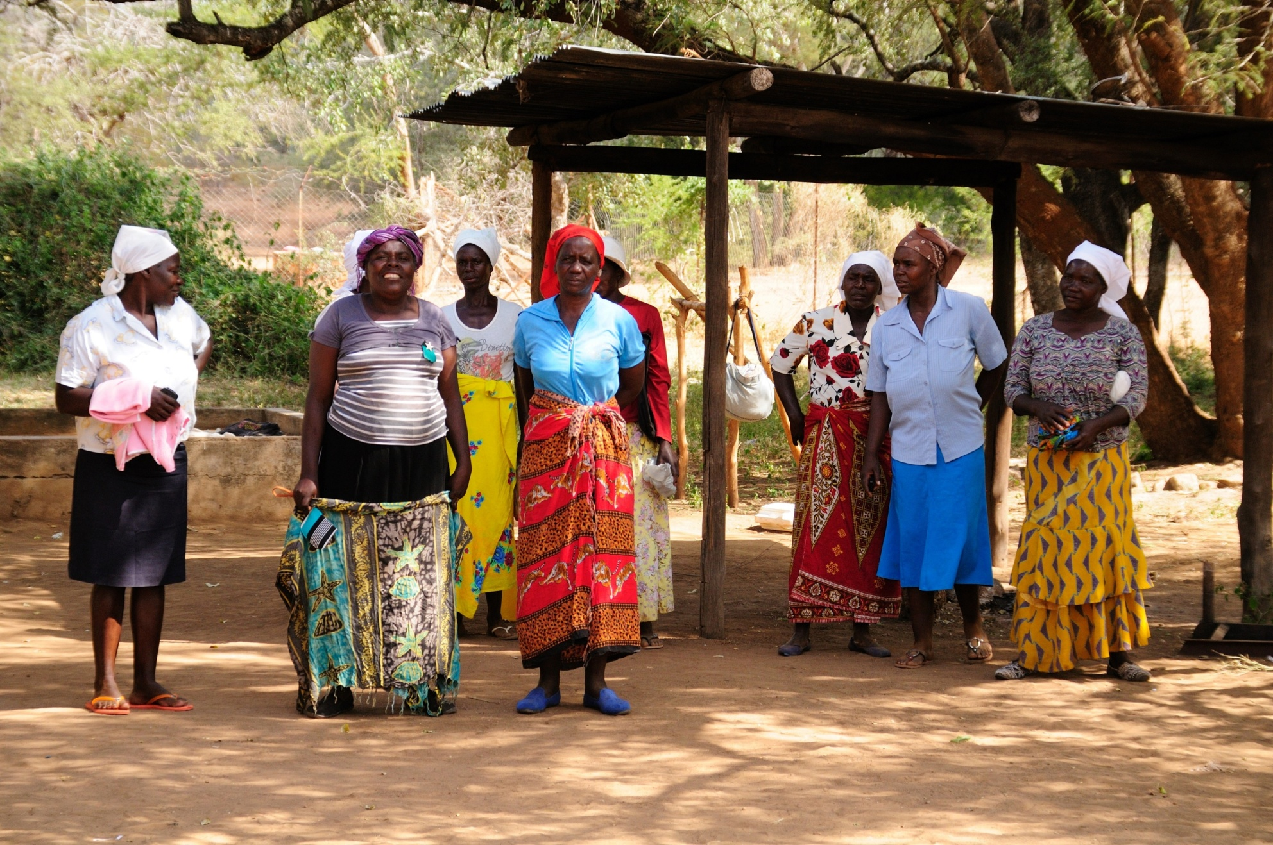
This ambitious goal will require the involvement of the community to cook and serve the students at each school.

Slide 23
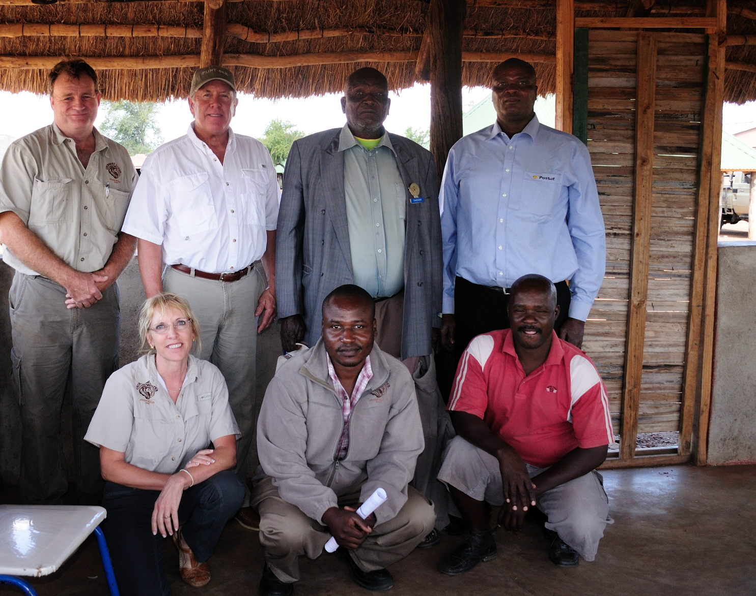
In addition to an official government in Zimbabwe, there are traditional leaders.
This is chief Tshovani, standing second from the right, and his son Felix, (junior chief), far right.
The chief supports our efforts in the CRC. He encourages the community to help us find and stop wildlife and habitat poachers. He understands the necessity of preserving the wildlife for tourism and job creation, while keeping his people safe and out of the Core Wildlife Area.
His ability to gather the manpower to feed the students will be instrumental in achieving our goals.
By working together we can improve lives.

Slide 24
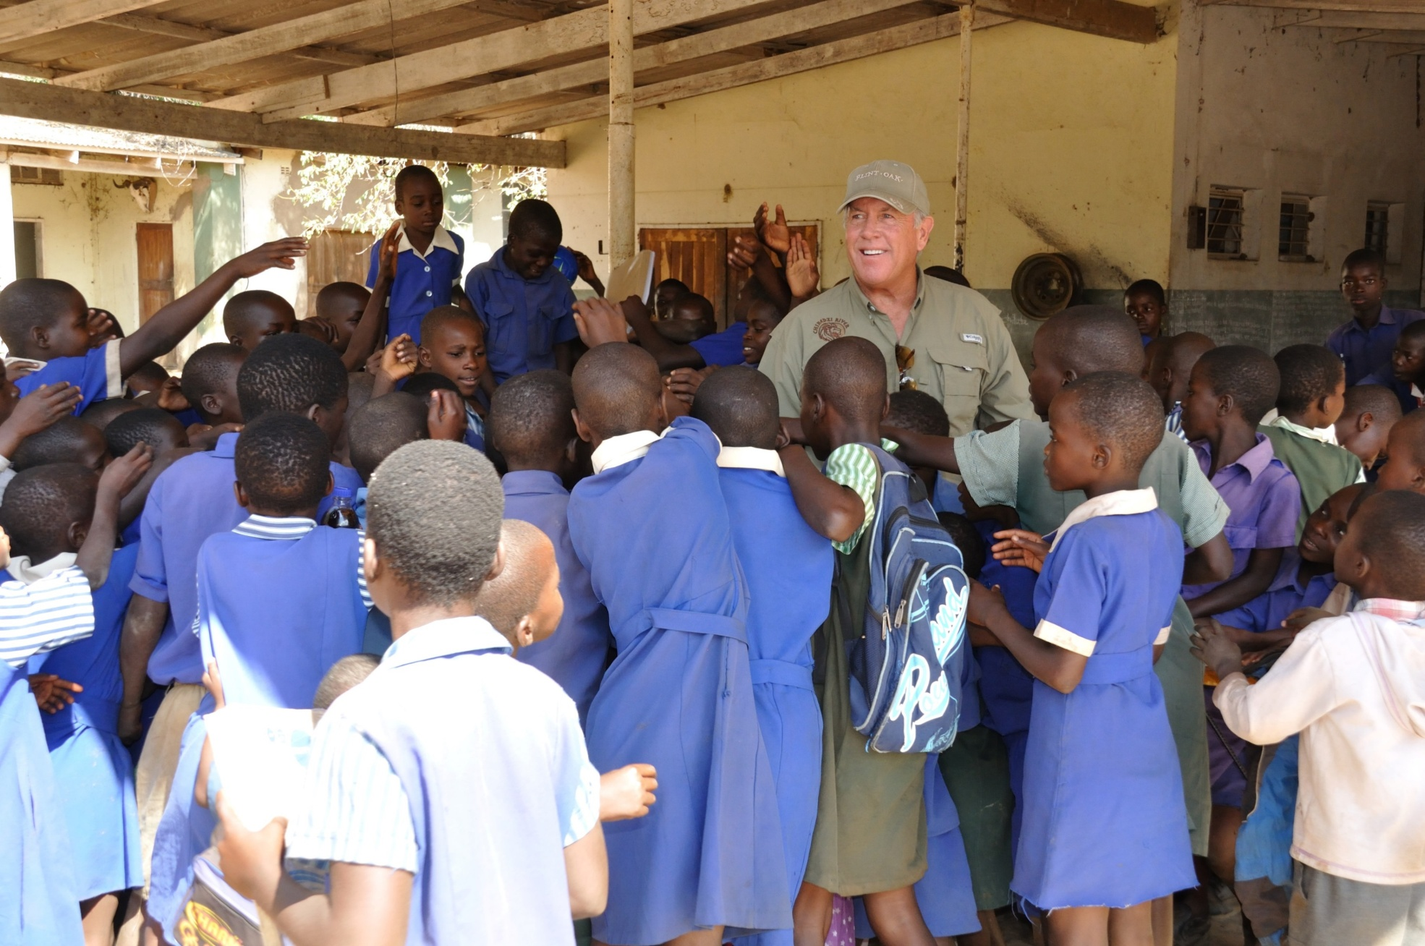
Our organization has lofty goals, but sometimes we’re not sure who gets the most out of our efforts.
Ron Kutter, Vice President of the Chiredzi River African Wildlife Trust

Slide 25
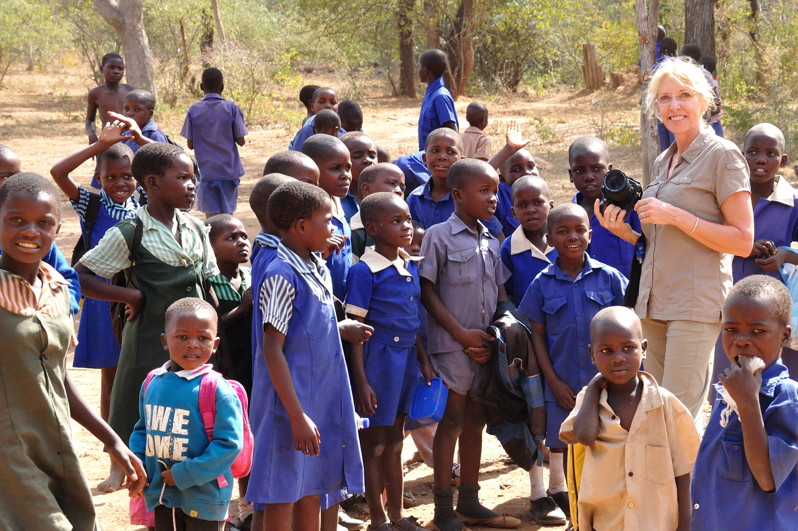
Keeping tabs on our efforts in Zimbabwe is crucial, but I never know who looks forward to the next visit the most…me? or them!
Lori Kutter, Secretary and Treasurer of the Chiredzi River African Wildlife Trust

Slide 26
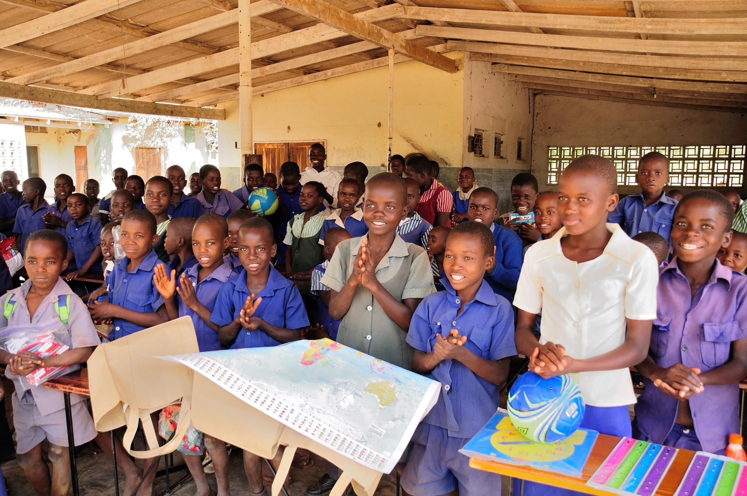
This my friends,
is a heartfelt
Thank You.

Slide 27
Project Budget and Commitments
River Pump Including Starter and Breaker $1,650
Piping to the reservoir and pump $600
5,000 liter tank, treated deck w/ piping and iso valves $1,200
500m x 50 mm HDPE piping w/ fittings and traps $1,400
Labor and installation $850
15% Value Added Tax (VAT) $855
Total Project Cost $6,555
Andover Rotary Club Contribution $2,400
District Simplified Grant $1,100
Remaining Funds to Secure $3,000
  Downtown Club
  Pratt Club
  Guymon Club
  Old Town Club

Slide 28
If you think you’re too small to make a difference,
you haven’t spent a night with a mosquito.
-African Proverb

